Slide 1
Data Sharing and Research Transparency in the Social Sciences: the Role of Academic and Scholarly Associations
Hosted by the
American Political Science Association
Sponsored by the Center for Qualitative and Multi-Method Inquiry, Syracuse University, and the Center for Political Studies, University of Michigan

Slide 2
Finding Common Ground
Political science is a highly fragmented discipline, epistemically diverse.
Trying to achieve coherent conversation about DA-RT by discovering shared understandings.
Requires recognition that, at a general level, we are all engaged in social inquiry.
Look to develop language to describe the elements of social inquiry, and the justification for making those elements public.

Slide 3
Evidence-based social Inquiry
Our prescriptive methodologies all involve:
extracting information from the social world,
analyzing the resulting data, and
combining evidence and its analysis to reach a conclusion.
Examples: ethnographic field work, a laboratory experiment, archive-based case study, or the statistical analysis of a large data set.

Slide 4
Openness about evidence-based social inquiry
to achieve research transparency
To enable secondary analysis, i.e. so another scholar can analyze the data
for pedagogical purposes.

Slide 5
Social science approach to openness is largely publication based
Main focus of my remarks will be on research transparency
Data and analysis underpinning published evidence-based claims.
Focus is on evaluation, including replication. Less concerned with other two data-use scenarios: secondary analysis, and pedagogical use.

Slide 6
Elements of research transparency
Requires providing four types of information needed to evaluate an evidence-based claim.
Data citation – what data were used and where are they?
Data access – are they available?
Production transparency – if authors’ own data, how were they produced? The documentation describing how the data were generated/collected.
Analytic transparency – what steps were conducted with the data to arrive at the conclusion? Explains how the evidence and claims are connected.

Slide 7
What exceptions are allowed for data access?
Commonly allowed for:
Classified documents
Proprietary constraints
Documents obtained under non-disclosure agreement
Human subjects
Logistical and practical impediments

Slide 8
Where must authors deposit data and other materials?
Different possibilities, varying along two main dimensions: degree of institutionalization, and amount of curation
Institutional venues provide expertise and resources.
Trusted digital repositories
Data-PASS
Dataverse
Curation: activities to manage, maintain, validate, and add value to research data, so they are available for reuse and preservation

Slide 9
Criteria for data (and their venue)
Usable: Include content that is in well-established machine-actionable digital formats.
Discoverable: In a place that provides a publicly available and freely searchable catalog.
Meaningful: Offer metadata, documentation and other materials needed to facilitate data re-use.
Citable: Facilitate formal data citation by assigning persistent, globally resolvable, machine- actionable identifiers that verifiably link to specific versions of data.
Secure: Maintain policies and procedural controls to protect confidentiality and personal privacy as required by law and the ethical standards of the research community.
Durable: Ensure long-term preservation of and access to their digital assets.

Slide 10
Different Data Venues
 | Personal Website | University Archive | Trusted Digital Repository
Usable |  | ? | 
Discoverable |  | ? | 
Meaningful |  | ? | 
Citable |  | ? | 
Secure |  | ? | 
Durable |  | ? | 

Slide 11
When must grantees deposit data and other materials?
Is it important to give authors first use?
Event from which time runs? Journal world runs on publishing cycle: manuscript submission, acceptance, publication.
Other timing mandates may trump (e.g. funder policies for study data set may preempt)

Slide 12
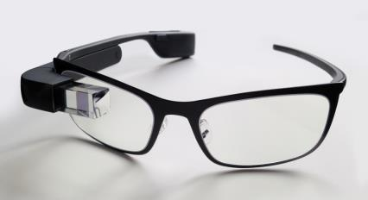

How much do researchers have to show?
Less than all
More than nothing

Slide 13
Heuristic principle: data that were used to make the published claim
Data Sharing
Research Transparency
Data only made available for secondary analysis (aka “study dataset”)
Data used to support an evidence-based claim (aka “replication dataset”)

Slide 14
Justification for research transparency
Social inquiry is process-dependent, but so are almost all intentionally created outcomes.
Not just that it is process-dependent, but that the central claim of social inquiry is that (in KKV’s famous phrase) “the content is the method.”
To put it another way, the process is part of the outcome. If you can’t see how the result was arrived at, you can’t see the result.

Slide 15
Social science produces privileged knowledge
Scholarly communities hold shared and stable beliefs that research designed and conducted in particular ways possesses certain characteristics.
The conduct of social inquiry and the written products that represent its conclusions are designed to capture those characteristics.
For any given piece of research in a particular tradition, the ability of scholars to claim the underlying warrants depends on their showing that it was designed and conducted in accordance with those rules.

Slide 16
Not true for all intersubjective knowledge. Example of a process-dependent outcome which remains wonderful even without knowing the process
Once more unto the breach, dear friends, once more;
Or close the wall up with our English dead.
In peace there's nothing so becomes a man
As modest stillness and humility:
But when the blast of war blows in our ears,
Then imitate the action of the tiger;
Stiffen the sinews, summon up the blood,
Disguise fair nature with hard-favour'd rage;
Then lend the eye a terrible aspect;
Let pry through the portage of the head
Like the brass cannon; let the brow o'erwhelm it
As fearfully as doth a galled rock
O'erhang and jutty his confounded base,
Swill'd with the wild and wasteful ocean. (Henry V)

Slide 17


Slide 18
Benefits of Research Transparency
Follow from previous discussion about epistemic justifications for openness.
Research methods are designed to capture the value-added of particular kinds of knowledge production processes. Only get to make those claims if done right.
Research transparency (data citation, data access, production transparency and analytic transparency) allow us to separate valid from invalid claims.

Slide 19
Benefits for the individual scholar
Increase visibility and reputation.
Higher citation counts.
Enables collaboration.
Can help establish links to the next generation of scholars.
Enables long-term safe storage for a researcher’s data.

Slide 20
Sharing Data
Empirical information extracted through social inquiry
Must include production transparency, i.e., the documentation detailing the process by which the data were generated or collected.
Can either be shared as a public good in their own right, or as part of research transparency.

Slide 21
Benefits of Sharing the “Study Dataset”
Costly, and difficult to generate, data are used more than once.
Data availability is node around which epistemic communities can form.
Provides opportunity to engage in analysis for evidence-based conclusions to scholars who otherwise could not have done so.
Data collection sites may not be re-visitable.
Aggregation and meta-analyses are made possible.
Some large scale data projects may only be possible as stand-alone multi-user multi-purpose initiatives (e.g. ANES, COW).

Slide 22
Pedagogical Benefits of Data Sharing
Third use scenario, teaching. Not using data as a public good for secondary analysis, or as a means to distinguish valid from invalid claims.
Leveraging availability of shared data and public statements of research transparency to teach.
Most obvious application is to teach research methods, but can also be used in substantive courses.
Variant of ‘active learning’ approach to pedagogy.

Slide 23
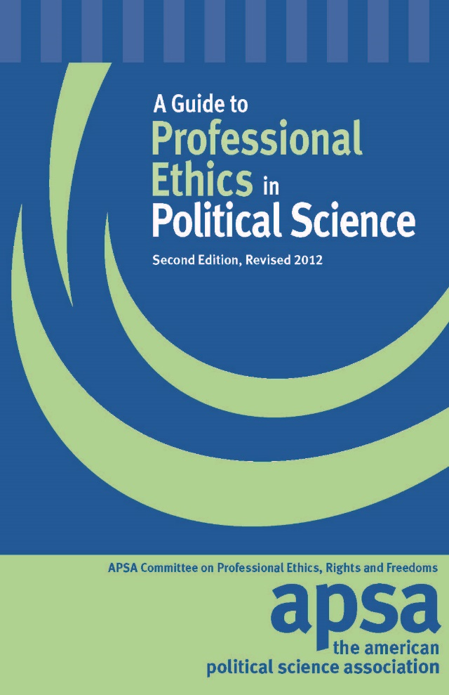
Political Science recently adopted data access and research transparency
6. Researchers have an ethical obligation to facilitate the evaluation of their evidence-based knowledge claims through data access, production transparency, and analytic transparency so that their work can be tested or replicated.
  6.1 Data access: Researchers making evidence-based knowledge claims should reference the data they used to make those claims. If these are data they themselves generated or collected, researchers should provide access to those data or explain why they cannot.
  6.2 Production transparency: Researchers providing access to data they themselves generated or collected, should offer a full account of the procedures used to collect or generate the data.
  6.3 Analytic Transparency: Researchers making evidence-based knowledge claims should provide a full account of how they draw their analytic conclusions from the data, i.e., clearly explicate the links connecting data to conclusions.

Slide 24
Social Inquiry
Social world
Artefacts
Measurement
Data
Analysis
Conclusions

Slide 25
Transparency as a universal obligation
Applies regardless of the type of evidence-based social inquiry being conducted.
For all evidence-based social inquiry, if you can’t see how the result was arrived at, you can’t see the result.

Slide 26
Universal but not homogenous
The justification for openness (showing both evidence and analysis) and the benefits of data sharing (maximizing use of data, secondary analysis etc.) apply to all research traditions.
The optimal means of achieving openness and data sharing respect the challenges and opportunities that characterize various research traditions.

Slide 27
Contrasting traditions
Different ways to organize and typologize research.
For example, could be by ontology (topic, puzzle, mechanism), discipline, episteme.
From a DA-RT perspective, helpful to separate epistemically, by type of data and mode of analysis. In evidence-based social sciences focused on causal analysis, can locate two central groupings: dataset and singular sources.

Slide 28
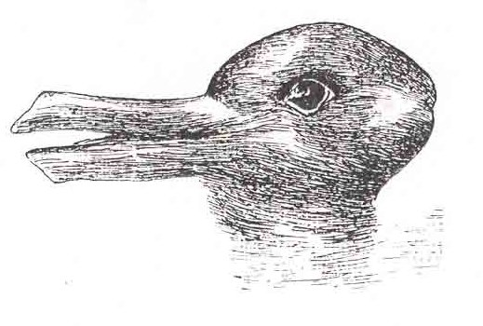
Research traditions see the world on their own terms

Slide 29
Dataset
Holistic analysis
Effects-of-causes

Slide 30
Singular Source Data
Sequential and/or conjunctural analysis
Causes-of-effects

Slide 31
Active Citation
the use of rigorous, annotated (presumptively) primary source citations hyperlinked to the sources themselves (Moravcsik 2010).
a way to make singular source approach to social inquiry accessible.

Slide 32
Active Citation
Traditional Format
Transparency Appendix
Contestable evidence-based claim in main text
Each entry has:
1. Full citation to source
2. Source excerpt
3. Annotation
4. Link to the original source (if available)
+
Note with citation and supplementary text

Slide 33
http://qdr.syr.edu

Slide 34
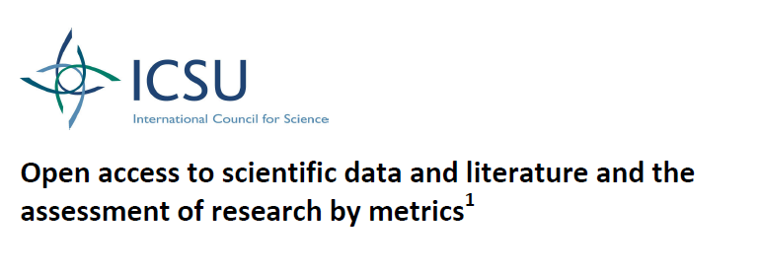
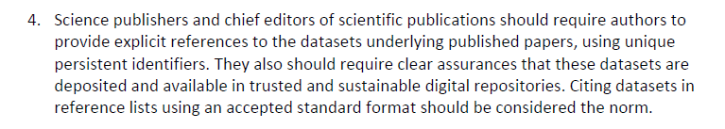
DA-RT is part of a conversation about transparency occurring in all sciences

Slide 35
Recent Developments in Data Sharing and Research Transparency
January 2011 – NSF requires data management plans for all proposals
February 2013 – Executive Office of the President’s Office of Science and Technology Policy memo “Increasing Access to the Results of Federally Funded Scientific Research”:
  Funding agencies with an annual R&D budget over $100m directed to develop a public access plan for disseminating the results of their research.

Slide 36
Recent Developments (cont’d)
June 2013 – ICPSR-Sloan multi-disciplinary meeting of journal editors, domain repository directors, and other stakeholders. Led to a published Call to Action
  http://datacommunity.icpsr.umich.edu/research-transparency-data-access-and-data-citation-call-action-scholarly-publications
September 2014 – APSA-CQMI-CPS-ICPSR meeting, political science journal editors. Led to joint statement in support of DA-RT
  http://datacommunity.icpsr.umich.edu/da-rt-workshop

Slide 37


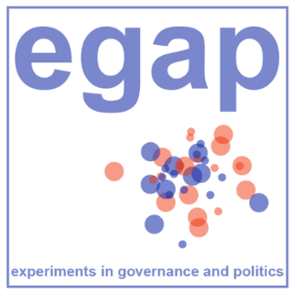

Some examples of organizations with interest in transparency

