Slide 1
Data Access, Research Transparency, and the Public Value of Science
Colin Elman, Syracuse University
@ArthurLupia, University of Michigan
DART

Slide 2
Outline
Our challenge:
If science does not make an increased commitment to transparency, what is its social value?
Our opportunity
Build needed incentives and infrastructure.

Slide 3
What is the public value of science?

Slide 4
Public and private sector decisions rely on
evaluations
of past actions.

Slide 5
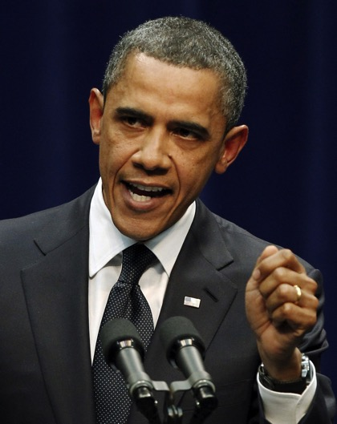
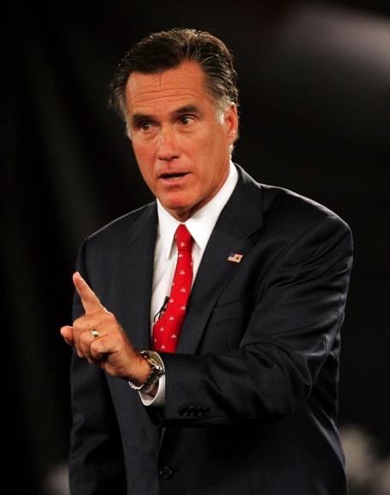

Slide 6
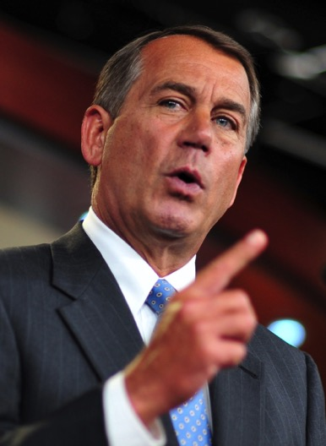
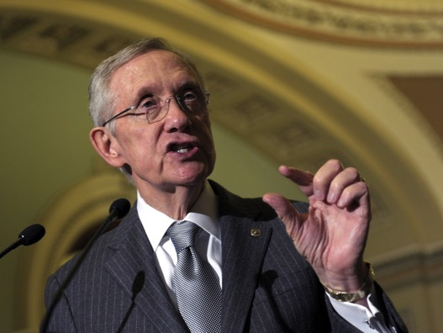

Slide 7
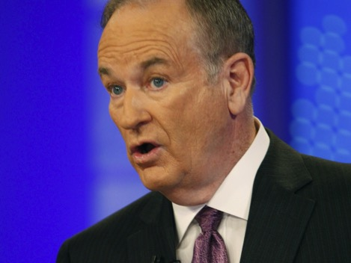
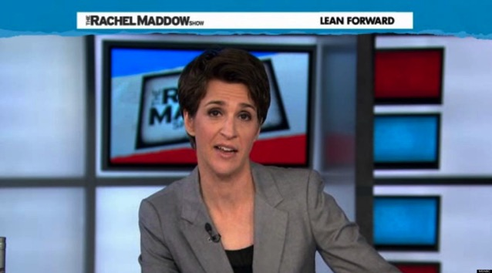

Slide 9
An ivory tower perspective

Slide 10
The communicative space is increasingly competitive

Slide 12
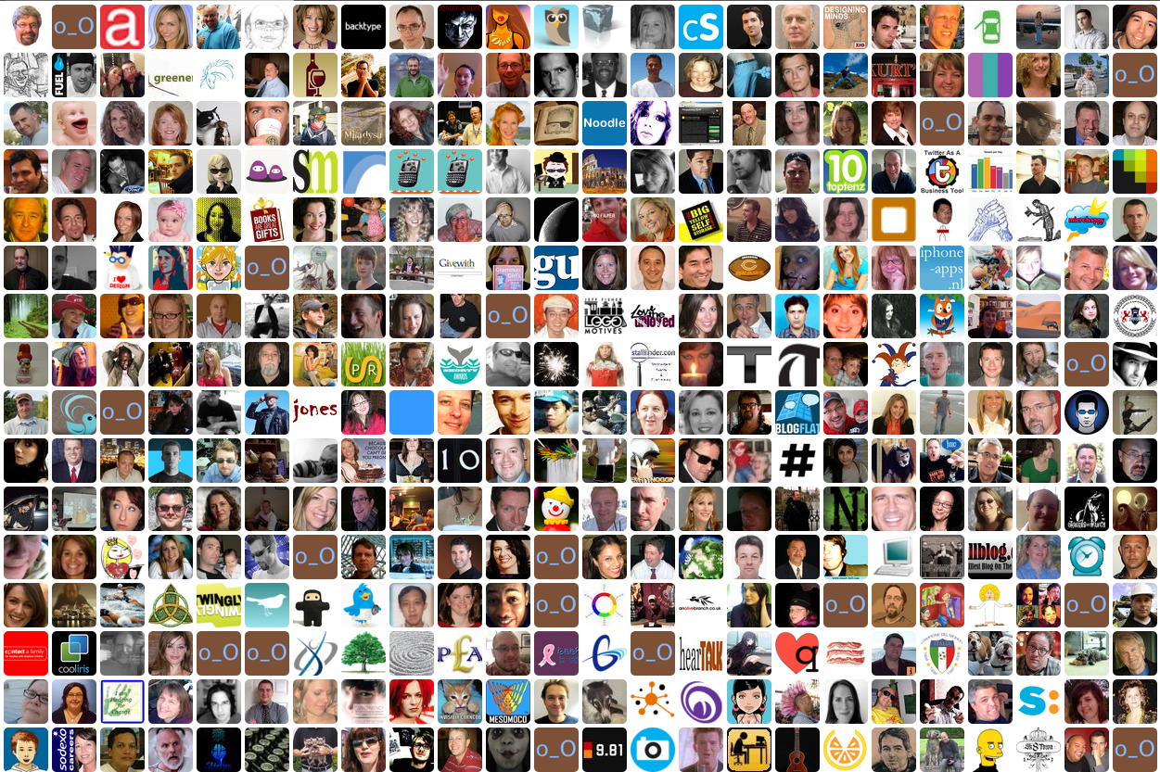

Slide 13
Which evaluations should they believe?

Slide 14
Evaluation Criteria
CREDIBLE
the quality of being believable or trustworthy
LEGITIMATE
in accordance with recognized or accepted standards or principles
Notes:
Replication.
Meaning.
Cumulation of knowledge.

Slide 15
What is the public value of science?
It is a source for credible and legitimate evaluations.

Slide 16
Richard Feynman (1974 – Caltech Commencement Address)
“[Scientific integrity] corresponds to a kind of utter honesty—a kind of leaning over backwards….

Slide 17
Richard Feynman (1974 – Caltech Commencement Address)
“…the idea is to give all of the information to help others judge the value of your contribution; not just the information that leads to judgment in one particular direction...”

Slide 18
What is the public value of science?
It is a source for credible and legitimate evaluations.

Slide 19
What is the public value of science?
Science allows a greater degree of honesty in evaluation

Slide 20
But…
Limited introspection and documentation
threatens the credibility and legitimacy of scientific research

Slide 21
The problem
Strong incentives to discover and publish
Weak incentives to explain how the discoveries emerged.

Slide 22
Our Opportunity

Slide 23
Many organizations are pursuing greater transparency
DART

Slide 24
DA-RT Components
Data Access
Research Transparency
Production Transparency
Analytic Transparency
DART

Slide 25
A. Data Access
To the extent that researchers’ evidence-based knowledge claims rely on data they themselves generated or collected, they should
provide access to those data
or explain why they cannot.
DART

Slide 26
B. Production Transparency
Researchers providing access to data should offer a full account of the procedures used to collect or generate the data.
DART

Slide 27
C. Analytic Transparency
Researchers making evidence-based knowledge claims should provide a full account of how they drew their analytic conclusions from the data
DART

Slide 28
“First Use” Principle
Researchers who collect or generate data have the right to use those data first.
Scholars may postpone data access for
for one year after publication or
for a period that publishers/funders specify.
Journals often require availability on publication.
DART

Slide 29
Many organizations are working with journal editors
DART

Slide 30
Working with Journal Editors
Premise: Scholars are motivated to publish in prestigious journals.
Goal: Numerous prestigious journals send a strong signal.
Constraint: Editors are serial autocrats and overworked.
Strategy: Success requires relationship building & community standards.
DART

Slide 31
DA-RT Joint Statement
27 of Political Science’s leading journals have agreed to increase transparency requirements by January 2016.
DART

Slide 32
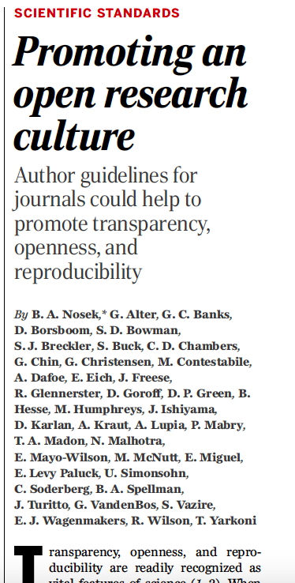
http://cos.io/top
Standards for author guidelines
8 standards
3 levels
>500 journals, >50 orgs (e.g., AAAS, APS, AGU, AHA, AMS, AAN)
Source: Brian Nosek and CoS

Slide 33
CoS Badges
Source: Brian Nosek and CoS

Slide 34
The $1M Preregistration Challenge
Sponsored by the John and Laura Arnold Foundation.
Administered by the Center for Open Science
One thousand researchers will win $1000 each for publishing research whose study and analysis plans are preregistered on the Open Science Framework.

Slide 35
Conclusion
To maintain legitimacy and credibility in competitive communicative environments, science must commit to greater transparency.
Our continuing social value requires increasing incentives and improving infrastructure for openness.

Slide 36
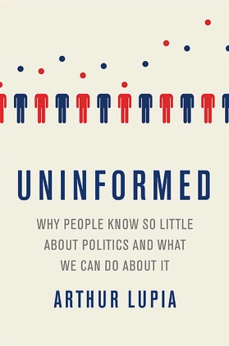
Thank you!
www.dartstatement.org @dartsupporters
https://osf.io/ @OSFramework
www.ArthurLupia.com @ArthurLupia

