Slide 1
Data Sharing and Research Transparency in the Social Sciences: the Role of Academic and Scholarly Associations
Hosted by the American Political Science Association
Sponsored by the Center for Qualitative and Multi-Method Inquiry, Syracuse University, and the Center for Political Studies, University of Michigan

Slide 2
How to Increase the Public Value of the Social Sciences
@ArthurLupia
University of Michigan

Slide 3
Introduction
Source material:
A. Lupia. 2014. “What is the Value of Social Science: Challenges for Researchers and Government Funders.” PS: Political Science and Politics 47: 1-7.
A. Lupia and C. Elman, eds. 2014. "Data Access and Research Transparency." PS: Political Science and Politics 47: 19-83.

Slide 4
Substantial funding of social science comes from taxpayer dollars

Slide 5
Why on earth would taxpayers or legislators support social science?

Slide 6
Taxes are not voluntary

Slide 7

Taxpayers with Questions

Slide 8
Reasonable Questions
To what end?
Of what value?
To whom?

Slide 9
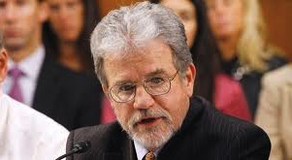
Senator Coburn

Slide 10
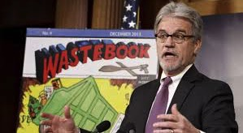
Wastebook

Slide 11
Moreover, the communicative space is increasingly competitive

Slide 12


Slide 13


Slide 14
What is the value of social science research?

Slide 15
Public and private sector decisions rely on
evaluations
of past actions.

Slide 17
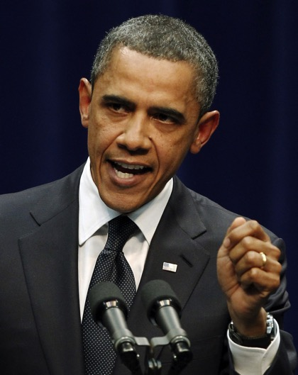
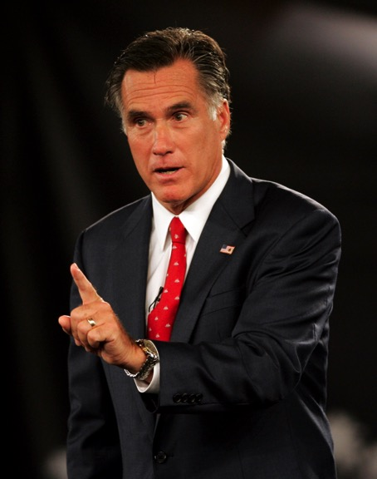

Slide 18
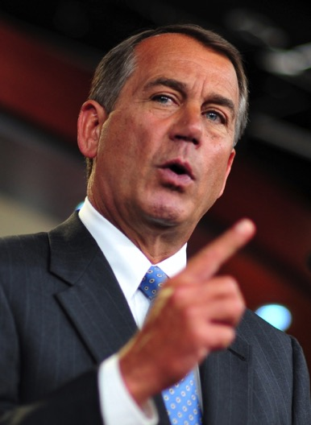
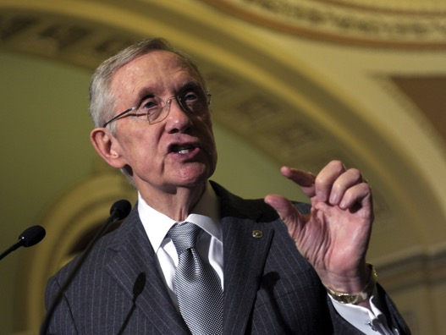

Slide 19
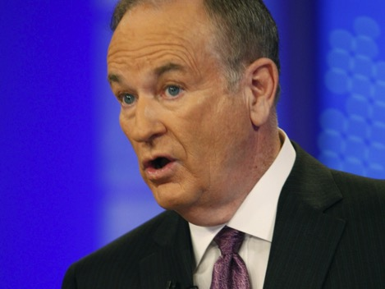
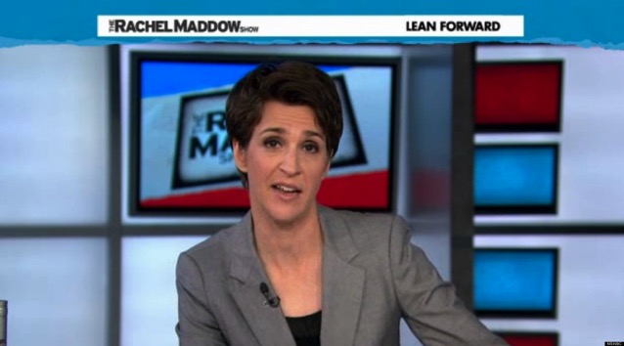

Slide 20
Which evaluations should we believe?

Slide 21
Evaluation Criteria
CREDIBLE
  the quality of being believable or trustworthy
LEGITIMATE
  in accordance with recognized or accepted standards or principles
Notes:
Replication.
Meaning.
Cumulation of knowledge.

Slide 22
What is the value of social science research?
It is a source for credible and legitimate evaluations.

Slide 23
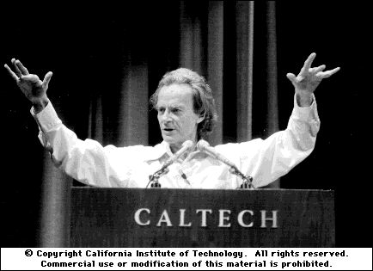
Richard Feynman (1974 – Caltech Commencement Address)
“[Scientific integrity] corresponds to a kind of utter honesty—a kind of leaning over backwards….

Slide 24
Richard Feynman (1974 – Caltech Commencement Address)
“…the idea is to give all of the information to help others judge the value of your contribution; not just the information that leads to judgment in one particular direction...”

Slide 25
DA-RT Principle
(Lupia & Elman 2011)
Three sources produce credibility and legitimacy
  Data Access
  Research Transparency
    Production Transparency
    Analytic Transparency

Slide 26
What is the value of social science research?
It is a source for credible and legitimate evaluations.

Slide 27
What is the value of social science research?
Science allows a greater degree of honesty in evaluation

Slide 28
Baghdad
Did the surge work?

Slide 29



Slide 30
Nils B Weidmann, Idean Salehyan. 2013.
Intl Stud Q 57: 52-64.
Baghdad, 2003-2008
  A spike in conflict
  A surge
  Violence declines

Slide 31
Why less violence?
Hypothesis 1:
  The surge detects and defeats insurgents
Hypothesis 2:
  Ethnic unmixing reduced contact

Slide 32
Data Accumulated from Different Sources
Ethnic composition of neighborhoods
Changes in settlement patterns over time
Location of violence
Date of violence

Slide 33
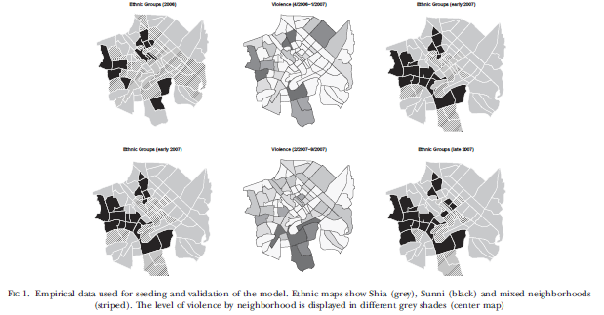

Slide 34
Weidmann-Salehyan Method
All data geocoded
Evaluate millions of possible ethnic-geo-time-violence patterns
Patterns provide estimates of how different policing policies would work

Slide 35
Findings
Most attacks against nearby ethnic rivals
  Attackers need “local” support.
Civilians search for safety
  Ethnic enclaves emerge & prepare
Ethnic segregation limits violence

Slide 36

Not just academic
Implication: Early “surge” most effective

Slide 37
Deliverables…
…are insights and discoveries that can improve people’s lives and the health of the nation.
…can come in the form of basic or applied research.
…provide significant tangible value to others

Slide 38
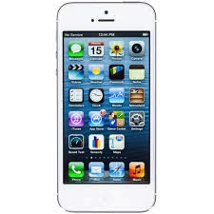
Iphone

Slide 39
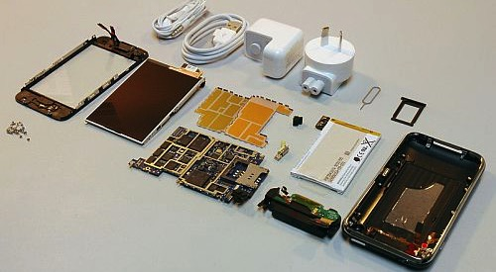
A result of basic and applied research

Slide 40
Social Science can…
Improve the effectiveness of socially valuable programs
Increase efficiency and effectiveness in the private sector
Improve citizens’ lives.

Slide 41
That’s the Good News…

Slide 42
But…

Slide 43


Slide 44
But…
Limited introspection and documentation
threatens the credibility and legitimacy of social scientific research

Slide 45
The problem
Strong incentives to discover and publish
Weak incentives to explain how the discoveries emerged.

Slide 46
DA-RT Principle
(Lupia & Elman 2011)
Three sources produce credibility and legitimacy
  Data Access
  Research Transparency
    Production Transparency
    Analytic Transparency

Slide 47


Slide 48
Today
Can we help you improve others’ perceptions of the important work that your members do?
We want to show you the progress that some have made.
We want to help you provide more value to your constituents.

