Slide 1
DA-RT & the Quest to Broaden the Supportive Coalition
@ColinElman, Syracuse University
@ArthurLupia, U of Michigan
@DARTsupporters

Slide 2
What is DA-RT?
Three sources produce credibility and legitimacy
Data Access
Research Transparency
Production Transparency
Analytic Transparency

Slide 3
DA-RT History
Origin: APSA Council
Multi-epistemic & multi-method
First actions:
Two year consultation and discussion
Ethics guide changes
PS Symposium on Transparency (January 2014)
Consulting with other social science disciplines
Now: DA-RT seeks to increase credibility and legitimacy by
by broadening the supportive coalition
and linking key decision makers to needed infrastructure.

Slide 4
APSA process – inclusive and steady
Two year consultation process involved
Lots of listening
Iterated interactions with multiple constituencies.
Contacts included
APSA council
ethics committee
publications committee
roundtables
short courses

Slide 5
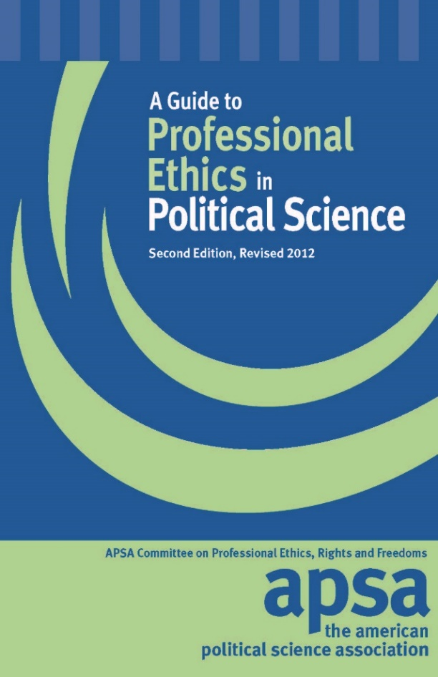
Political Science and DA-RT
6. Researchers have an ethical obligation to facilitate the evaluation of their evidence-based knowledge claims through data access, production transparency, and analytic transparency so that their work can be tested or replicated.
6.1 Data access: Researchers making evidence-based knowledge claims should reference the data they used to make those claims. If these are data they themselves generated or collected, researchers should provide access to those data or explain why they cannot.
6.2 Production transparency: Researchers providing access to data they themselves generated or collected, should offer a full account of the procedures used to collect or generate the data.
6.3 Analytic Transparency: Researchers making evidence-based knowledge claims should provide a full account of how they draw their analytic conclusions from the data, i.e., clearly explicate the links connecting data to conclusions.

Slide 6
DA-RT Principle
Evidence‐based knowledge claims need
citations to the data, and
an explanation of how the data and claims are connected.
If data are in author’s charge, the author must
provide access, and
documentation describing how they were generated/collected.

Slide 7
Constraints:
A) address human subjects concerns
B) comply with relevant and applicable laws, including copyright
C) provide first use of data by scholar who generated them.

Slide 8
How do we get to widespread change?

Slide 9
Headwinds
People have doubts and fears.

Slide 10
“Must go faster!”

Slide 11
There’s no need to worry because….

Slide 13
Next Steps
To to widespread change, agreement on principle is not enough.
We need
Relationship building
Broadly applicable incentive structures
“Plug and play” infrastructure

Slide 14
Sept 2014 Workshop
Pursue points of agreement on key issues, including:
Data citation practices
Data access requirements (timing, embargoes, exemptions)
Research transparency requirements (e.g. sharing code, analysis plans)
Find ways to provide support and create incentives for effective implementation.

Slide 15
Progress
Live on October 31, 2014.
25 journals have signed so far, including:
American Journal of Political Science
American Political Science Review
British Journal of Political Science
Comparative Political Studies
Conflict Management & Peace Science
Cooperation & Conflict
European Journal of Political Research
European Union Politics

Slide 16
International Interactions
International Security
Italian Political Science Review
Journal of Conflict Resolution
Journal of Peace Research
Journal of Politics
Journal of Theoretical Politics
Party Politics
Political Analysis
Political Behavior
Political Methodologist
Research and Politics
Security Studies
State Politics & Policy Quarterly

Slide 17
How to Help Editors
Provide some help articulating standards that respect their research traditions.
Point them towards plug and play infrastructure.
They can achieve their goals without hiring additional staff or other large investments (expertise in code or data checking).

Slide 18
The Joint Statement
Proposed by editors. Can be seen at http://www.dartstatement.org
Goal: A document that can help editors from many research traditions achieve credibility and legitimacy aspirations.

Slide 19
Commitment 1
1. Require that cited data are available at the time of publication through a trusted digital repository.
Plus advice about restricted data.

Slide 20
Commitment 2
2. Require clear delineation of the analytic procedures upon which published claims rely.
Where possible, provide access to all relevant materials.
Otherwise, share as much as possible through a trusted digital repository.

Slide 21
Commitment 3
3. Data citation policy: require explicit citations of all data used in claims.
Elements include:
a dataset’s author(s),
title,
date,
version,
and a persistent identifier.

Slide 22
Commitment 4
4. Ensure that journal style guides, codes of ethics, publication manuals, etc. include improved data access and research transparency requirements.

Slide 23
@DARTsupporters
www.dartstatement.org

